Slide 1

Heart Disease Prediction Using Gradio
Capstone Project
Joyce Rajendran Nadar
September 2024
NTUC

Slide 2
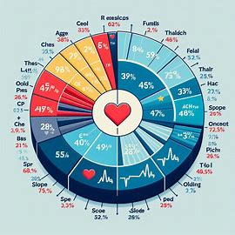
Introduction to Heart Disease
Heart disease: A leading cause of death globally.
Early prediction can save lives.
This project aims to develop a predictive model using machine learning.
Utilizes Gradio for an interactive interface.

Slide 3
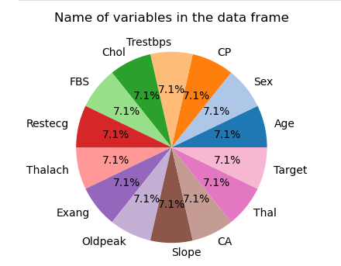
Key parameters
Age: Older age is linked to higher heart disease risk, influencing the likelihood of disease.
Sex: Gender plays a role, with different heart disease risks for males and females.
Chest Pain Type: Types of chest pain (e.g., typical angina) provide varying risk levels for heart disease.
Resting Blood Pressure: High resting blood pressure signals cardiovascular risk.
.
Notes:
A machine learning model uses these features to learn patterns and predict the likelihood of heart disease based on new data.

Slide 4
Key parameters
Serum Cholesterol: Elevated cholesterol increases heart disease risk.
Fasting Blood Sugar: High blood sugar, linked to diabetes, raises heart disease risk.
Resting ECG Results: Abnormal ECG results may indicate heart disease.
Maximum Heart Rate: Lower max heart rate during exercise may suggest poor heart health.
Exercise-Induced Angina: Exercise-related chest pain is a sign of coronary artery disease.
.
Notes:
A machine learning model uses these features to learn patterns and predict the likelihood of heart disease based on new data.

Slide 5
Key parameters
Exercise-Induced Depression: Depression during exercise can indicate more severe heart conditions.
Slope of ST Segment: ST segment slope changes during exercise signal heart disease or ischemia.
Major Vessels Colored: More vessels visible in tests may indicate severe coronary artery disease.
Notes:
A machine learning model uses these features to learn patterns and predict the likelihood of heart disease based on new data.

Slide 6
Key parameters
Thalassemia: Affects blood oxygenation and contributes to heart disease risk.
Target: The model's goal is to predict whether a patient has heart disease based on these parameters.
Notes:
A machine learning model uses these features to learn patterns and predict the likelihood of heart disease based on new data.

Slide 7
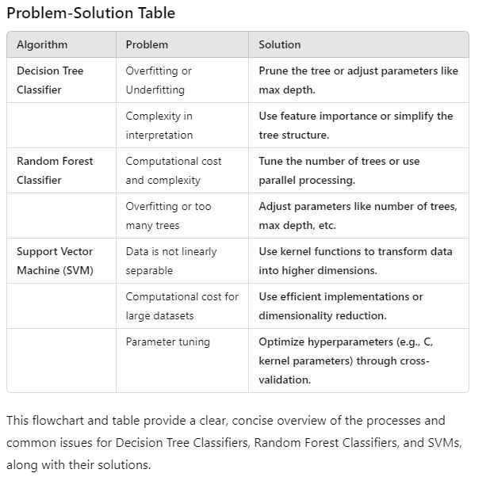
Problem
Difficulty in Early Detection: Heart disease often shows subtle symptoms, making early diagnosis challenging.
Limited Accessibility to Predictive Tools: Predictive tools and diagnostic methods may not be readily available in all regions or to all demographics.

Slide 8
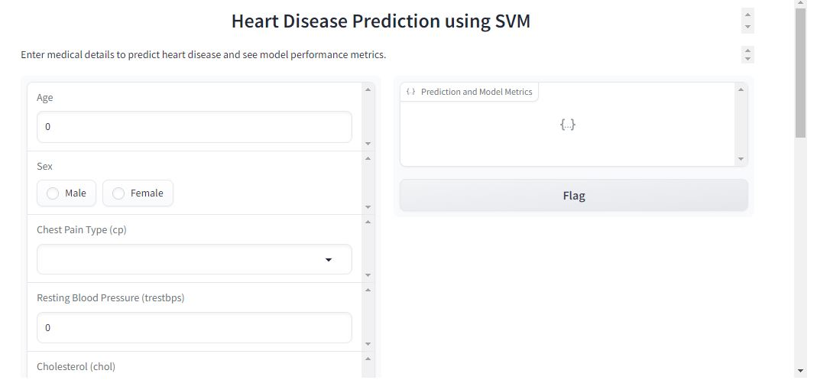
Solution - Aim
Create an Accessible Prediction Tool:
The goal is to develop a user-friendly, web-based heart disease prediction tool that can be used globally, even in regions with limited access to healthcare resources.

Slide 9
Solution - Approach
Flowchart/Timeline:
Data Collection: Gather medical data from patients (age, cholesterol levels, etc.).
Feature Selection: Identify the most relevant health indicators for heart disease.
Model Development: Use machine learning to build a prediction model.
User Interface: Develop an accessible interface using Gradio for users to input health metrics.
Deployment: Deploy the Gardio on Kaggle or other platforms for easy access.
This visual representation highlights the problem's scope and demonstrates the progression toward creating a solution that can help with early detection

Slide 10
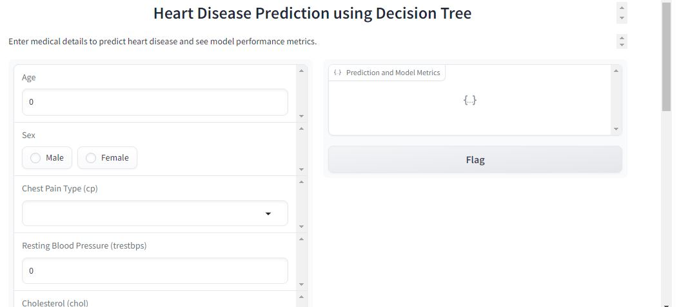
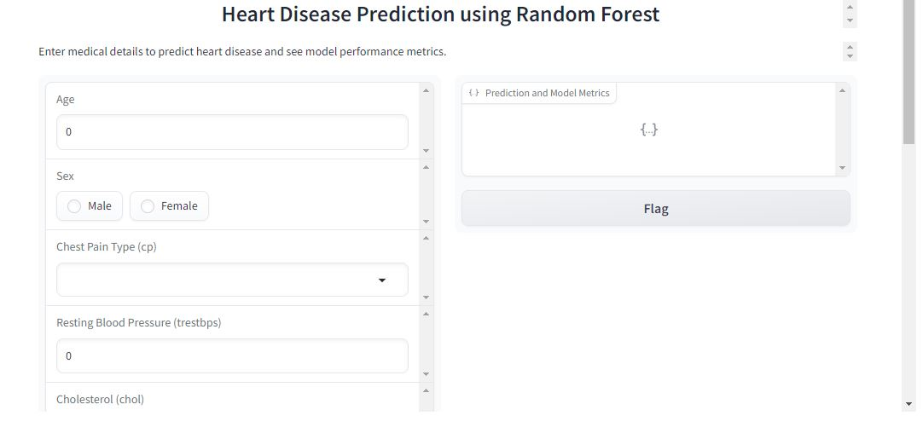

Slide 11
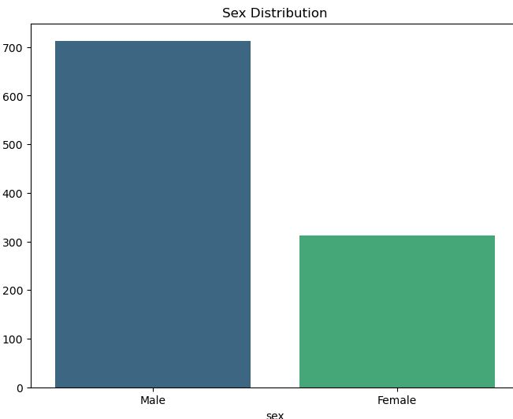
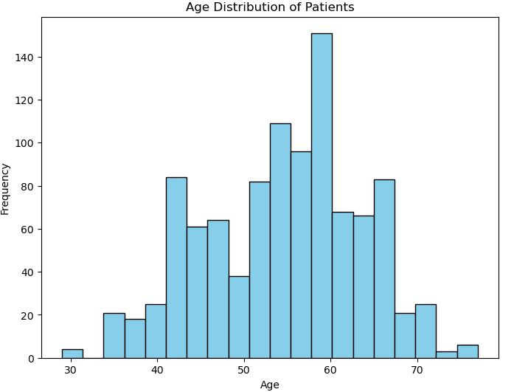
Exploratory Data Analysis (EDA)
Age distribution: Majority between 50-60 years.
High cholesterol strongly correlated with heart disease.
Insights guide feature selection

Slide 12
Feature Selection
The variables cp, thalach, slope, and target are positively correlated with heart disease, suggesting that these factors are common among patients with heart disease.
The variables exang, oldpeak, thal, and target have strong negative correlations, suggesting that as these variables increase, the likelihood of heart disease decreases.
This correlation analysis can guide feature selection for predictive modeling or give insights into the relationships between the variables in the dataset.

Slide 13
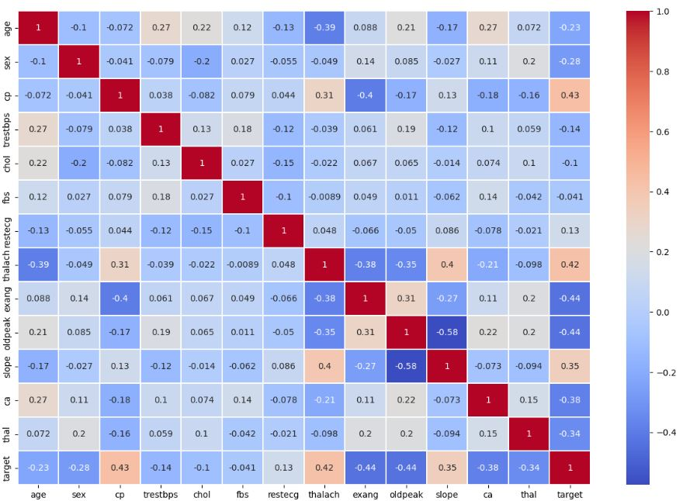
Feature Selection
Notes:
shows a series of histograms for various variables from the heart disease dataset (heart_info.csv). Each plot represents the distribution of values for a specific feature.

Slide 14
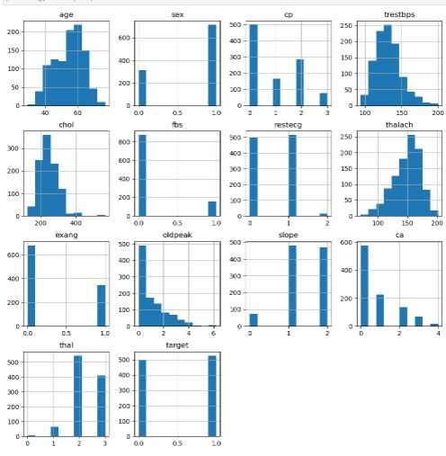
Feature Selection - Histogram

Slide 15
Feature Selection - Histogram
Age:
The distribution is slightly skewed to the right, with most patients in the 50-60 age range.
Sex:
This variable is binary, with more patients in category 1 (likely male) compared to category 0 (likely female).
Chest Pain Type (cp):
The most common chest pain type is category 0, with fewer patients in categories 2 and 3.

Slide 16
Feature Selection - Histogram
Resting Blood Pressure (trestbps):
This is a continuous variable, and the majority of patients have resting blood pressure between 120 and 140 mmHg.
Cholesterol (chol):
Cholesterol levels are spread, but most patients have values between 200 and 300 mg/dL.
Fasting Blood Sugar (fbs):
This is also binary, with most patients having fasting blood sugar below 120 mg/dL (0).

Slide 17
Feature Selection - Histogram
Resting Electrocardiographic Results (restecg):
Most patients fall in category 1, indicating normal ECG results, with fewer patients in categories 0 and 2.
Maximum Heart Rate Achieved (thalach):
This variable shows a nearly normal distribution, with the majority of patients having heart rates between 140 and 170 bpm.
Exercise-Induced Angina (exang):
Most patients do not experience exercise-induced angina (category 0), while fewer experience it (category 1).

Slide 18
Feature Selection - Histogram
Oldpeak (ST depression):
The distribution is right-skewed, meaning most patients have low ST depression values.
Slope of the ST Segment (slope):
The most common slope is category 2, indicating a normal or flat slope, with fewer patients in categories 1 and 0.
Number of Major Vessels Colored by Fluoroscopy (ca):
Most patients have 0 major vessels colored, with decreasing numbers for 1-3 vessels.

Slide 19
Feature Selection - Histogram
Thalassemia (thal):
Most patients fall in categories 2 and 3, with fewer in categories 1 and 0.
Target (Presence of Heart Disease):
This is a binary outcome, with 1 representing the presence of heart disease and 0 representing its absence. Most patients in the dataset likely have heart disease (category 1).

Slide 20
Model Selection
Evaluated Logistic Regression, Random Forest, and SVM models for heart disease prediction. Logistic Regression, while interpretable, struggled with non-linear relationships.
SVM, though powerful, was computationally expensive and less interpretable.
Random Forest was chosen for its balance between performance and interpretability.
It handled non-linearity well and provided insight into feature importance.

Slide 21
Model Selection
Random Forest outperformed the other models in terms of accuracy and precision.
Accuracy measured the overall correctness, while precision minimized false positives, critical in medical diagnosis.
The ability of Random Forest to handle complex interactions between features made it the best choice.
Ultimately, it provided both strong predictive performance and useful insights for feature selection.

Slide 22
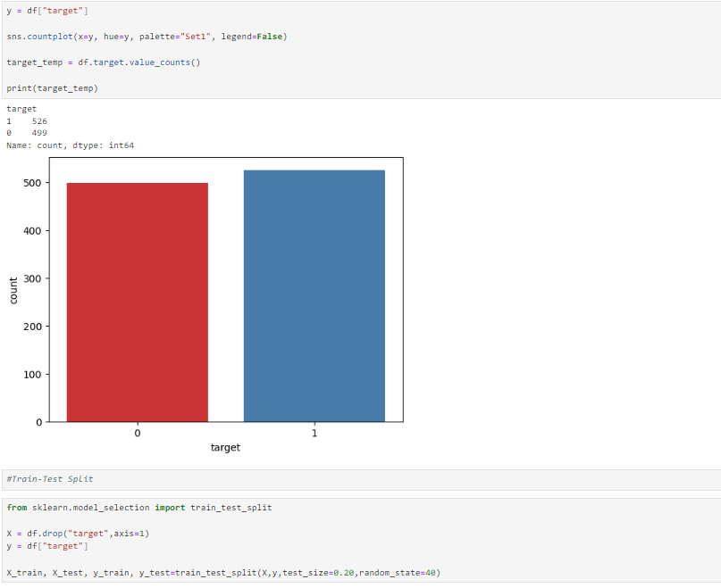

Slide 23
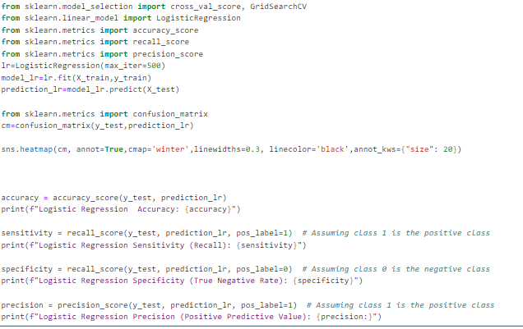
Logistic Regression

Slide 24
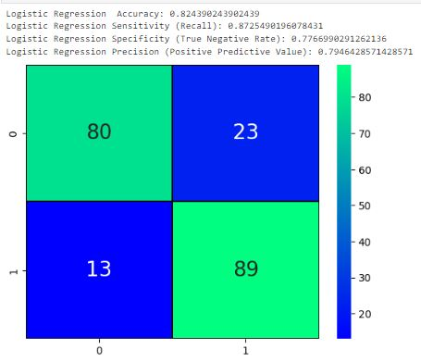
Logistic Regression

Slide 25
Decision Tree Classifier
A Decision Tree Classifier is a machine learning algorithm used for classification tasks.
It creates a tree-like model where each internal node represents a decision based on a feature, branches represent outcomes, and leaf nodes represent class labels. The tree splits data recursively to make decisions, with the goal of classifying new samples based on the learned patterns.
It’s easy to interpret but can overfit if not managed properly.

Slide 26
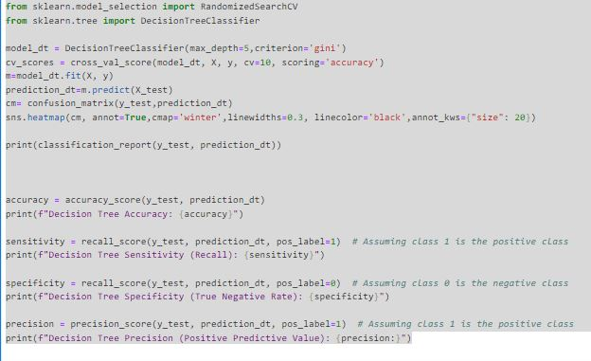
Decision Tree Classifier
Training accuracy: 90%.
Overfitting avoided with cross-validation.
Key metrics: Precision, recall, F1-score.

Slide 27
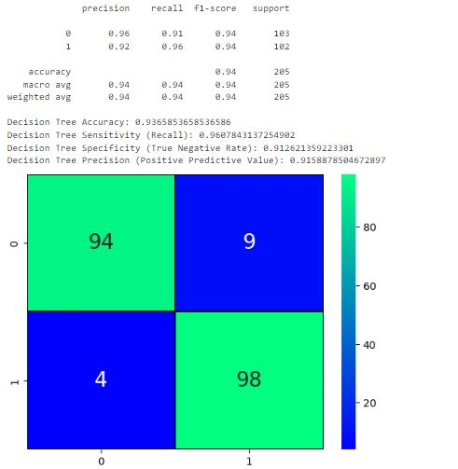
Decision Tree Classifier
Test accuracy: 85%.
ROC curve: AUC score of 0.88.
Confusion matrix shows balanced performance.

Slide 28
Random Forest Classifier
A Random Forest Classifier uses multiple decision trees to improve classification accuracy.
Each tree is trained on random data and features, and the final prediction is based on the majority vote from all trees.
It reduces overfitting, handles large and complex datasets well, and is robust to noise.

Slide 29
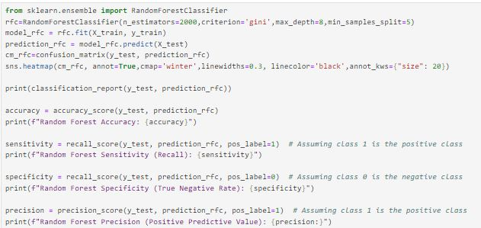
Random Forest Classifier

Slide 30
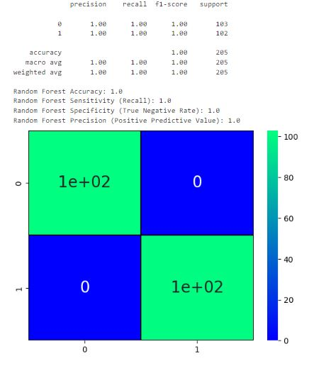
Random Forest Classifier

Slide 31
Support Vector Machine (SVM)
Support Vector Machine (SVM) is a classification and regression algorithm that finds the optimal hyperplane to separate different classes with the maximum margin.
It uses support vectors (closest points to the hyperplane) to define this boundary and can handle both linear and non-linear data through kernel functions.

Slide 32
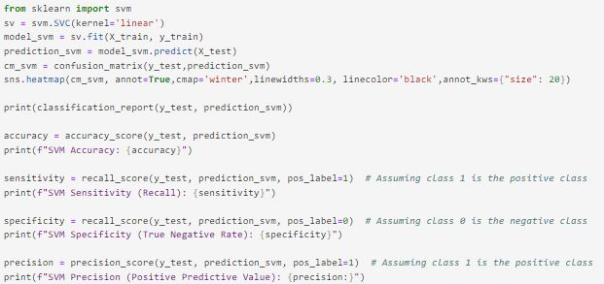
Support Vector Machine (SVM)

Slide 33
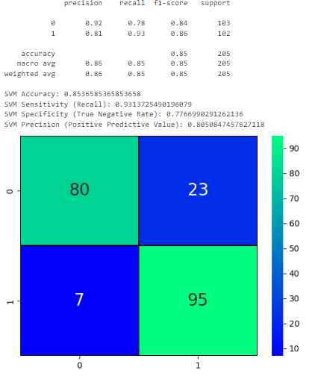
Support Vector Machine (SVM)

Slide 34
Gradio
Gradio: A Python library for building interactive UIs.
Allows non-technical users to interact with models.
Key features: Easy setup, customizable UI.

Slide 35
Gradio
Integrated the Random Forest model with Gradio.
Users input features, receive real-time predictions.
Simple and user-friendly interface.

Slide 36
Gradio
Input fields for key features (e.g., age, cholesterol).
Prediction output: Probability of heart disease.
Visual feedback on predictions.

Slide 37
Impact and Applications
Real-world impact: Potential to assist doctors in early diagnosis.
Can be expanded to other medical predictions.
Potential integration with health apps.

Slide 38
User Testing and Feedback
Conducted testing with users.
Positive feedback on ease of use.
Minor adjustments made based on feedback.

Slide 39
Future Work
Improve model accuracy with more data.
Explore deep learning models.
Expand Gradio app features.

Slide 40
Impact and Applications
Real-world impact: Potential to assist doctors in early diagnosis.
Can be expanded to other medical predictions.
Potential integration with health apps.

Slide 41
Conclusion
Successfully built a heart disease prediction model.
Integrated with Gradio for user interaction.
Project demonstrates the potential of AI in healthcare.

